Slide 1




Tech Days 2021 Flight into IoT

Slide 2









Flight into IoT System Diagram
Service Bus Queue
Logic
App
3rd Party Services
IoT Hub
Time Series Insights
Device Provisioning Service
Stream Analytics
Power BI

Slide 3
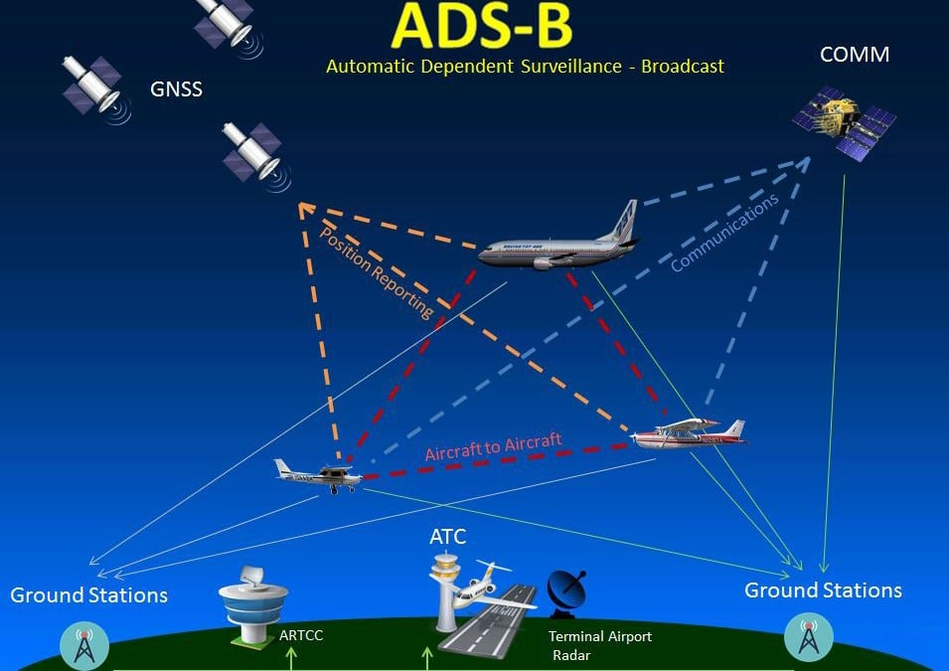
Flight into IoT ADS-B

Slide 4
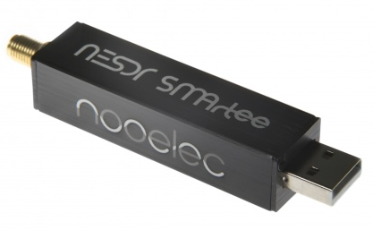
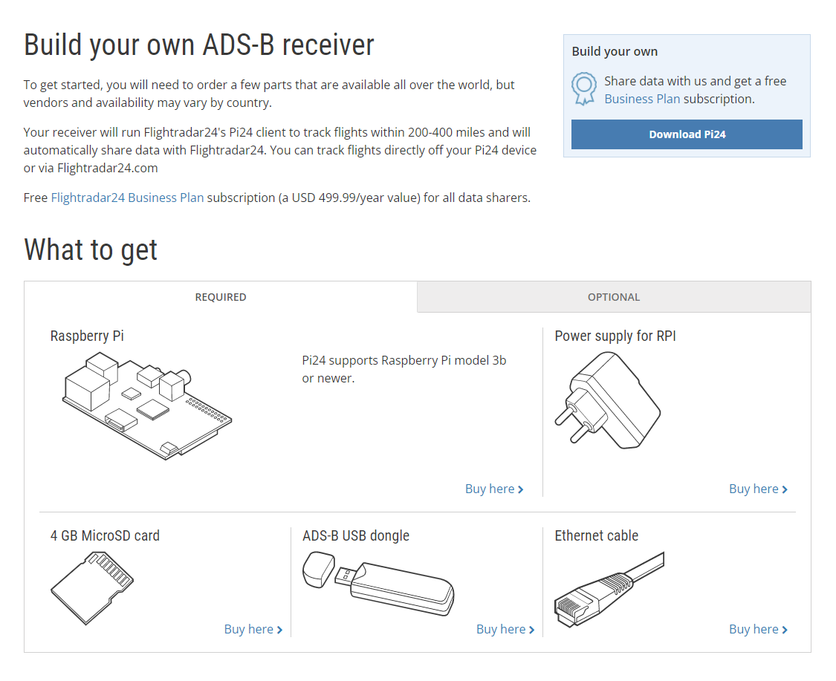
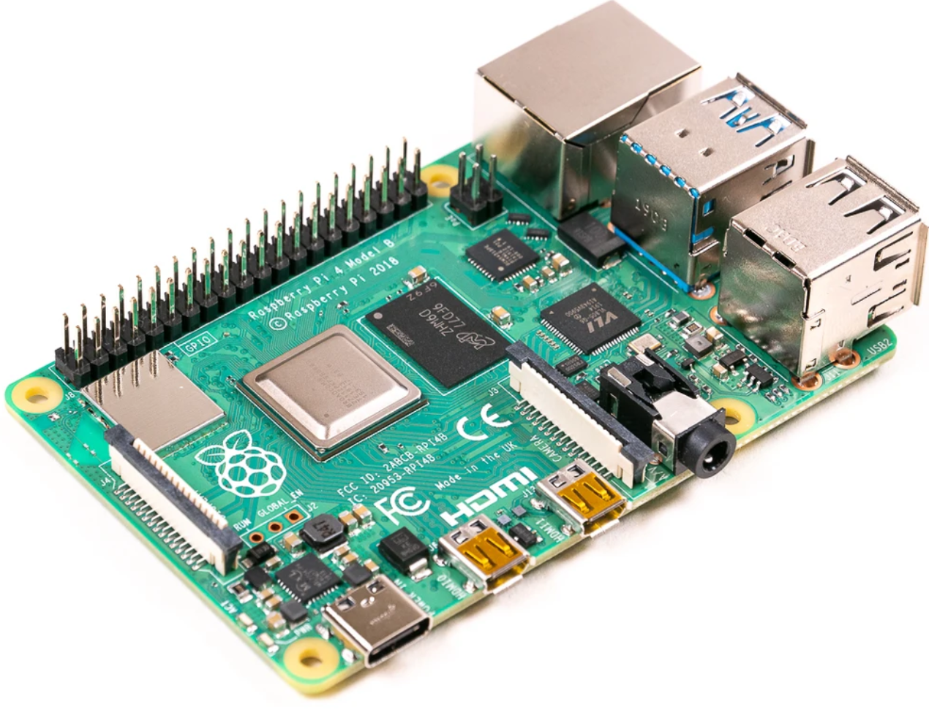
Flight into IoT ADS-B
https://www.flightradar24.com/build-your-own

Slide 5
Flight into IoT Useful Links
Cloud Skills Challenge
https://docs.microsoft.com/learn/challenges
GitHub Repo
https://github.com/CliffAgius/TechDays2021

Slide 6
Thankyou
Q&A

